Slide 1
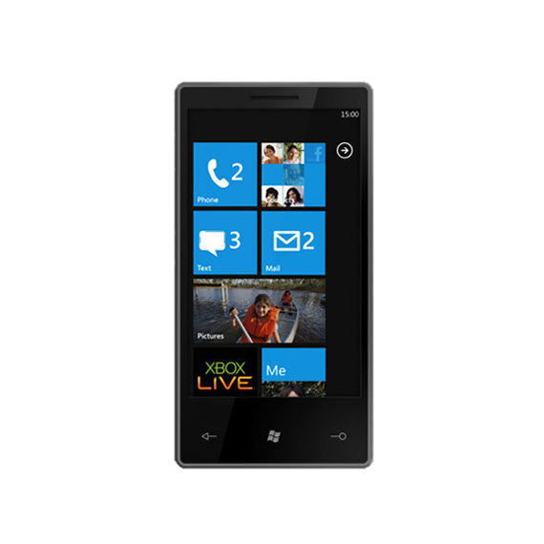





Slide 2
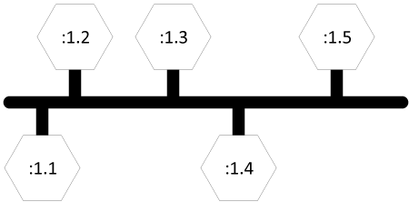
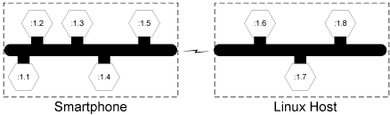
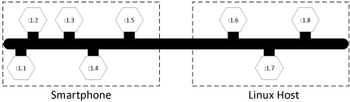
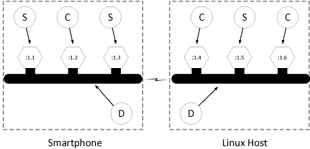
We want this to seamlessly look like this

Slide 3
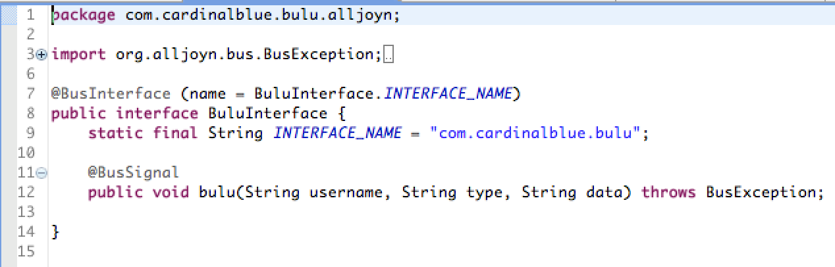
Interface spec
com.cardinalblue.bulu

Slide 4
Interface spec
com.cardinalblue.bulu
Implementation at
/buluService
Implementation at
/buluService/richContent

Slide 5

Interface spec
com.cardinalblue.bulu
com.cardinalblue.bulu.alice
Implementation at
/buluService
Implementation at
/buluService/richContent
com.cardinalblue.bulu.bob

Slide 6

Limitations
Elaborations
https://github.com/fumin/fumin.github.io/blob/master/mopcon_2013/talk.md
https://www.alljoyn.org/
https://github.com/fumin/bulu-ios
https://github.com/fumin/bulu-android

